Slide 1

Shop Billing Management System

Slide 2

Our Project is for shopkeeper.

Slide 3
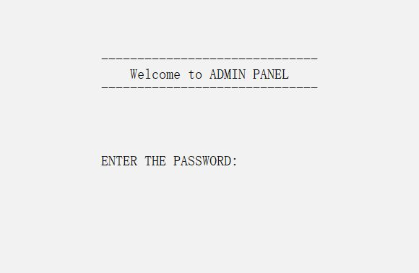
First Step:
First we’ve to give the password to enter the code.

Slide 4
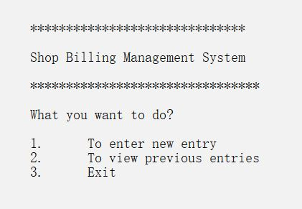
Second Step:
We’ll get these three options for the next step

Slide 5
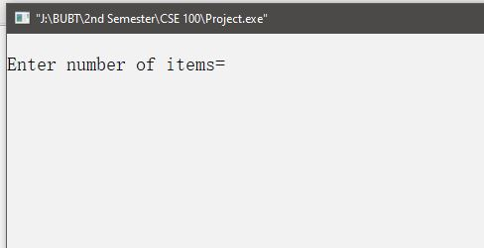
Third step:
After choosing option 1, we’ll get the option of select number of items.

Slide 6
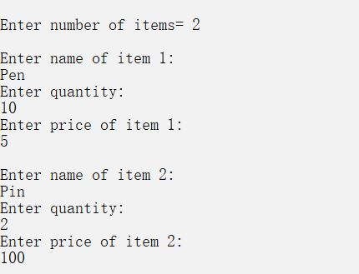
Fourth step:
Choosing number of items, we can add the item name , quantity and price.

Slide 7
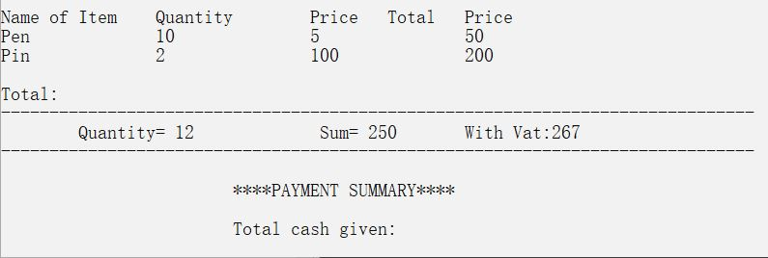
Fifth step:
We can see the summary of the item details with the prices.

Slide 8
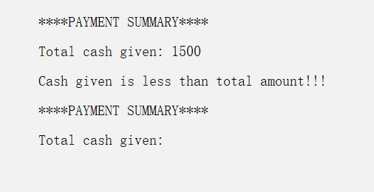
Sixth step:
If customer pay less then the total cost amount , then have to pay again.

Slide 9
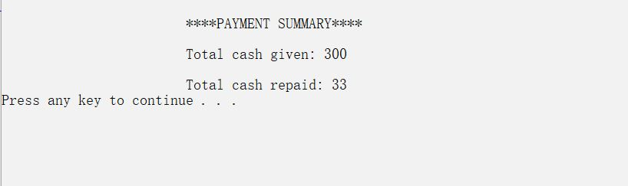
Seventh step:
After your payment , customer will return the change.

Slide 10
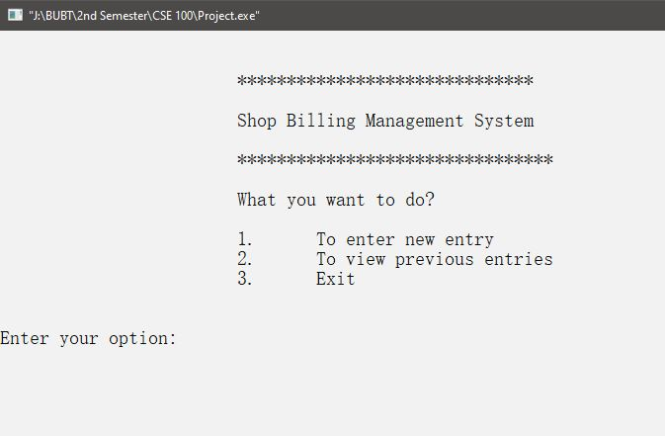
EITGHT STEP:
Again we’ll get the options.

Slide 11
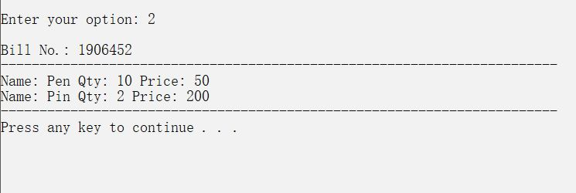
Ninth Step:
After selecting option 2, we’ll get the previous details of sell.

Slide 12
Tenth Step:
Again we’ll get those options.

Slide 13
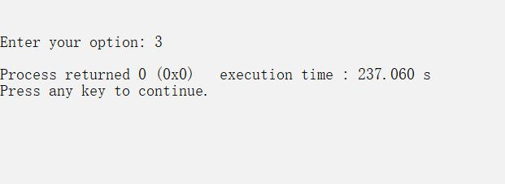
ELEVENTH STEP:
After selecting option 3, the project will be finished.

Slide 14
THANK YOU
SUBMITING BY:
Badrun Nahar Luna
21224103052
2. Meharab Hossain
21224103064
3. Samiya Akter Mim
21224103056
4. Sadia Afroz
21224103058

